Slide 1
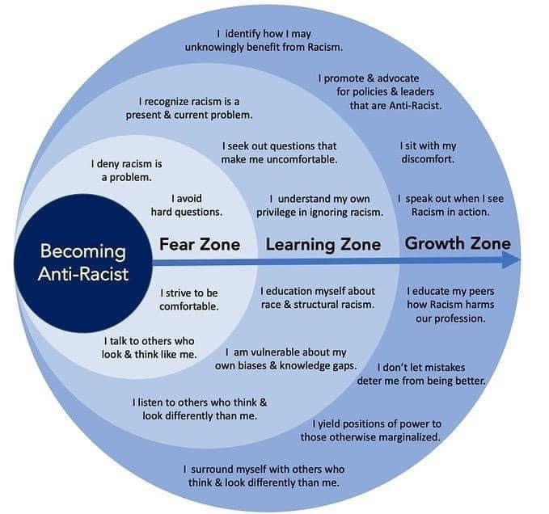
Becoming Anti-Racist

